Slide 1
Designing a better future: Active, actionable DMPs
Sarah Jones
Digital Curation Centre, Glasgow
sarah.jones@glasgow.ac.uk
Twitter: @sjDCC
Open Research Data Management: policies and tools, Milan, 24-25 May 2017

Slide 2
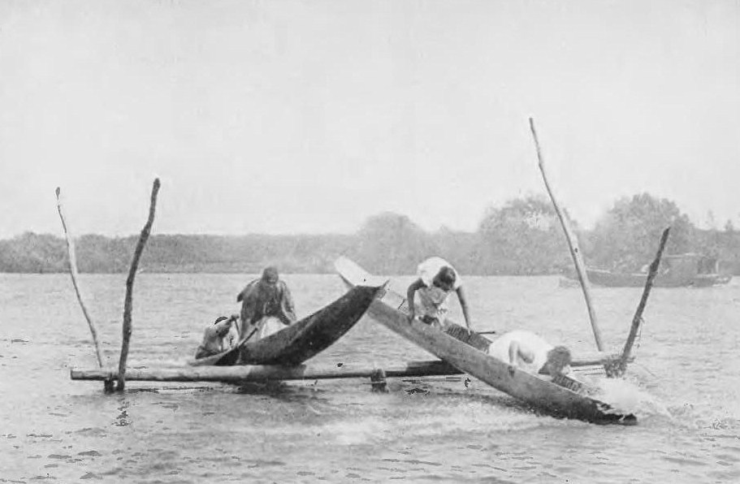
By Josiah Martin public domain

Slide 3
Planning & administration
Create, analyse, manage data
Publishing & reuse
DMP on periphery
Often done at grant stage and not looked at again
Opportunities to (re)use information being missed
Disconnected & unlinked

Slide 4
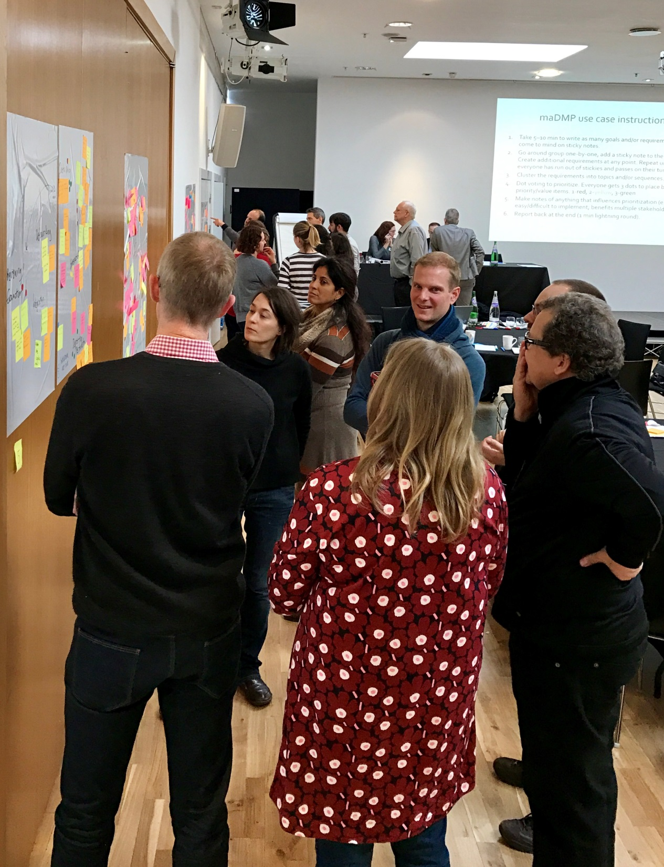
Utopia workshop
47 participants from 16 countries
Funders
Developers
Librarians
Service providers
Researchers
Understand research workflows
Develop use cases for maDMPs
Set priorities for future work
www.dcc.ac.uk/events/workshops/postcard-future-tools-and-services-perfect-dmp-world

Slide 6
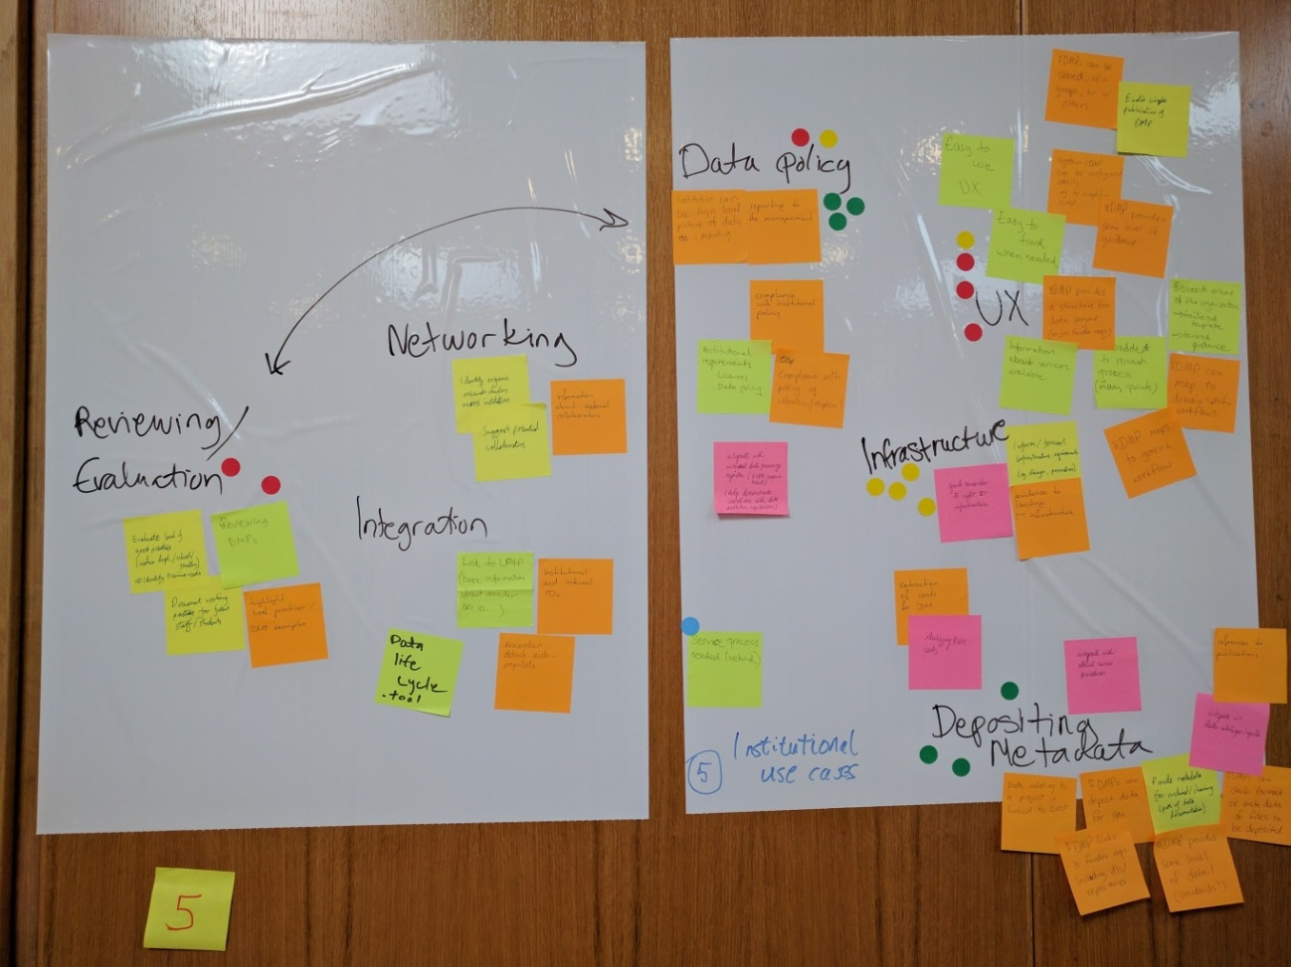
Uses cases and prioritisation
Interoperability with research systems
Institutional perspective
Repository use cases
Evaluation & monitoring
Leveraging PIDs

Slide 7
maDMP priority areas
Common standards and protocols
Utilising PIDs for automatic reporting etc
Capacity planning (institutional & data centre)
Increasing data discovery & reuse
Supporting evaluation & monitoring
Share/publish/deposit DMPs
Improve the experience for all by exchanging information across research systems and embedding DMPs in existing workflows

Slide 8
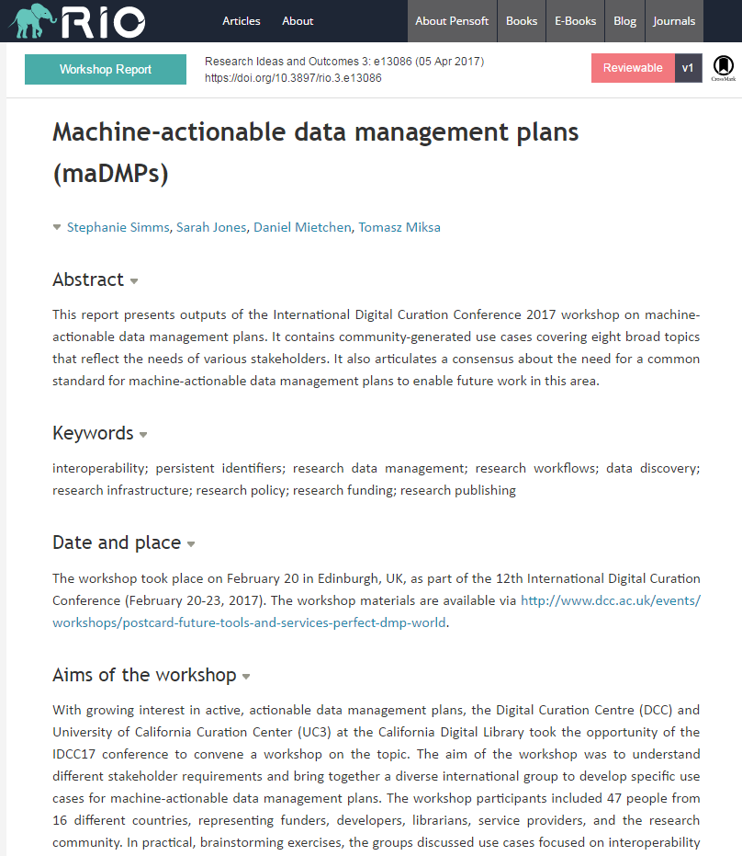
White paper for comments
Share your needs
Help us iterate
Provide your time, ideas, resources to help pilot work
http://riojournal.com/articles.php?id=13086

Slide 9
Define a minimum data model
DMPonline themes
Mappings
Common format?
New RDA Working Group on this topic
From Flickr by Steve Johnson, CC BY 2.0

Slide 10
The problem of freetext
Templates typically ask very broad questions, even when dropdown options are feasible (e.g. metadata standards, file formats, data volumes, repositories, licences…)

Slide 11
Registries to give structured response
http://rd-alliance.github.io/metadata-directory

Slide 12
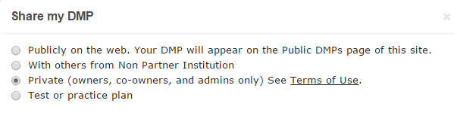
Publishing DMPs
Open DMPs demonstrate good research practice and facilitate data discovery and reuse. They could also be aggregated and mined to identify trends.
Public DMP list
Institutional sharing
Deposit in Zenodo (or other repos)
Publish in RIO (or other journals)

Slide 13
Service join-up & capacity planning
2-way info exchange between DMP & repository
Specify place of deposit
Notify repository
Share data volume & requirements
Facilitate deposit by prepopulating forms
Update DMP with dataset metadata & PID
DMP
Repository

Slide 14
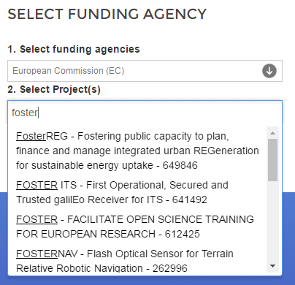
Utilising PIDs
Potential to use EC grant IDs in plans e.g.
Harvest grant IDs from OpenAIRE API
Provide look up when entering project details
Prepopulate metadata fields
Enable join up of DMP with other outputs

Slide 15
Next steps: maDMP pilots
From Flickr by Allen, CC BY 2.0

Slide 16
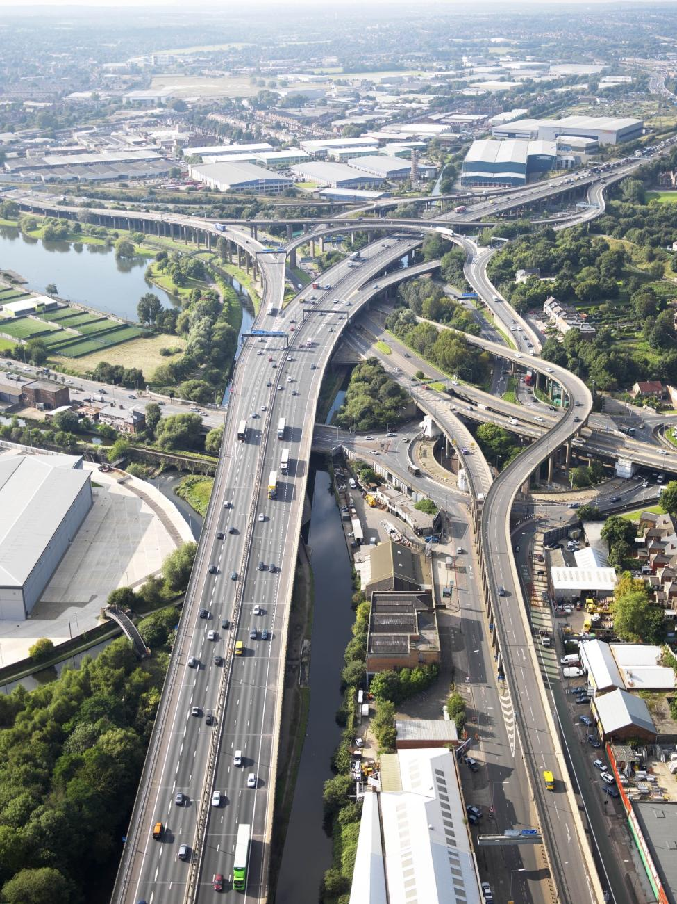
Summary
Think of DMPs as key elements of a networked data management ecosystem:
connected via a shared vocabulary
actionable by humans and software
versioned
public
From Flickr by highwaysengland, CC BY 2.0

Slide 17
Engage with us for more!

Slide 18
Thanks for listening
DCC resources on Data Management
www.dcc.ac.uk/resources
Follow us on twitter:
@DMPonline and #ActiveDMPs

